Slide 1



Slide 2



 | Slope Bins 4 | Smear Count 25
Block number | Alpha w/ Henderson Hasselbalch | Chi Chi_max = 2.2
[0 50] | 0.040012 | 1.160000
[50 75] | -0.278451 | 0.720000
[75 125] | -0.519707 | 0.608000
[125 156] | -0.154453 | 0.529032

Slide 3


 | Slope Bins 4 | Smear Count 31
Block number | Alpha w/ Henderson Hasselbalch | Chi Chi_max = 2.2
[0 31] | 0.001103 | 0.922581
[31 62] | -0.386873 | 0.703226
[62 93] | -0.290146 | 0.967742
[93 496] | 0.037164 | 1.098759
[496 527] | -0.064533 | 0.819355
[527 620] | 0.010682 | 0.756989
[620 647] | -0.103326 | 0.696296

Slide 4
Approach
B, and v will be different for L and H
Chi should be same
Match pure L and H first, then mix
SCFT Purpose:
Additional information of underlying protein organization
Possible underlying conformational change driven by Cs

Slide 5
Summary

Slide 6









b2.0 v2.7 c3.2
b3.0 v3.5 c3.5
b3.0 v7.0 c3.5
b3.0 v7.0 c3.0
Phi too small
Phi too small to decrease v0
b4.0 v12.0 c3.0
b5.0 v20.0 c3.0
b5.0 v20.0 c4.0
b5.0 v5.0 c3.0
b5.0 v10.0 c3.0
Phi too small to decrease v0

Slide 7

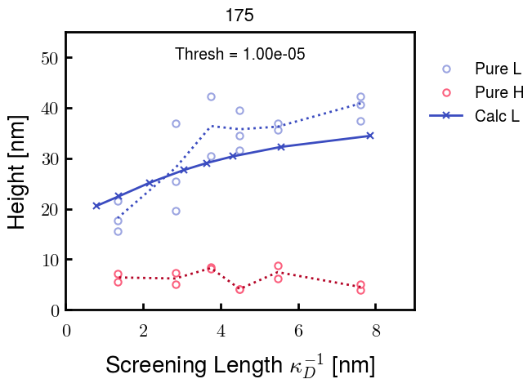
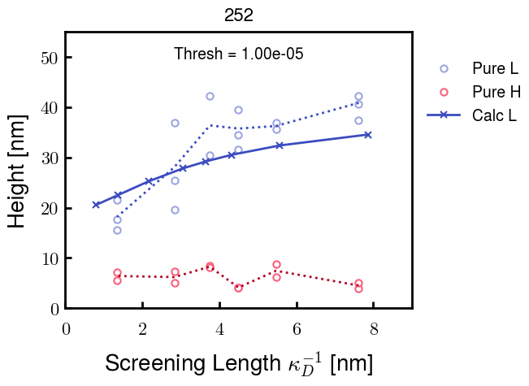



v2.7 and some fine
b1.50 v2.7 c3.2
b1.75 v2.7 c3.2
b1.75 v2.5 c3.2
b1.75 v2.5 c3.0
b2.0 v2.7 c3.2
b2.25 v2.7 c3.2
b2.50 v2.7 c3.2

Slide 8




b2.00 v2.70 c3.20
b2.00 v2.75 c3.20

Slide 9
NFH fitting (from NFL best fit)

Slide 10








b1.00, v0.50, c3.2
b2.00, v4.00, c3.2, th2.5e-02
b1.00, v2.00, c3.2
b1.00, v1.00, c3.2

Slide 11
Mixture

Slide 12



Slide 13


b = 0.75

Slide 14





Slide 15
b = 1.0

Slide 16





Slide 17
b = 1.25

Slide 18




Chi 2.6
Bad vol frac

Slide 19








b25v0
b25v1
b25v2
b25v3

Slide 20




Chi 2.8
Bad vol frac

Slide 21





Slide 22
b = 1.50

Slide 23






Chi 2.8
Bad vol frac

Slide 24





Slide 25

b = 2.00
v4 = 0.25*b^3

Slide 26


Bad vol frac

Slide 27



Slide 28
Fine tune

Slide 29



b1.25, v1.95, c3.0
b1.50, v3.38, c3.0
b2.00, v4.00, c3.0
Norm seems to capture kinked behavior

Slide 30




Slide 31



b1.25, v1.95, c3.2
b1.50, v3.38, c3.2
b2.00, v4.00, c3.2

Slide 32




Slide 33


b1.25
b1.50
b2.00
c2.8
c3.0
c3.2

